Slide 1

ARTIFICIAL INTELLIGENCE
&
MACHINE LEARNING
SESSION NO : 22
Linear Models – Part 1: Linear Regression

Slide 2
Regression in Machine Learning
Regression is a supervised learning technique where the goal is to predict a continuous numerical value based on one or more independent features.
Regression is a fundamental technique for predicting continuous outcomes based on input features.
It is used in many real-world applications like price prediction, trend analysis and risk assessment.
With its simplicity and effectiveness regression is used to understand relationships in data.

Slide 3
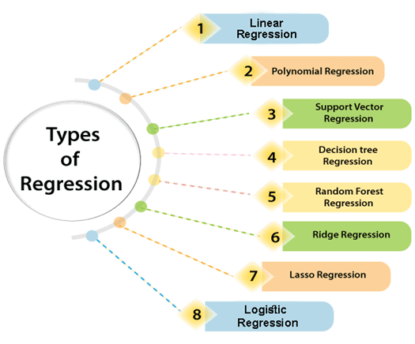
Types of Regression

Slide 4
Linear Regression
Linear regression – machine learning model that is used to predict the values of output variables based on the value of input variables.
It predicts the relationship between two variables by assuming they have a straight-line connection.
It finds the best line that minimizes the differences between predicted and actual values.
Linear regression is a quiet and the simplest statistical regression technique used for predictive analysis in machine learning.
Linear regression shows the linear relationship between the independent (input) variable i.e. X-axis and the dependent (output) variable i.e. Y-axis.

Slide 5
Real World Use Cases of Linear Regression
A straight-line relationship (linear regression) can be applied between the input (independent variable) and the output (dependent variable) for these use cases.
  Predicting house prices based on square footage.
  Estimating salary based on years of experience.
  Forecasting crop yield based on rainfall amount.
  Predicting weight based on height.
  Estimating fuel consumption based on distance traveled.
  Predicting electricity bill based on monthly usage (kWh).
  Estimating temperature based on altitude.
  Predicting blood pressure based on age.

Slide 6
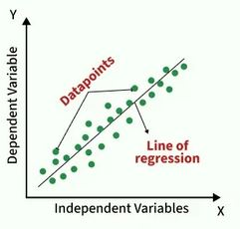
Steps in linear regression
Step 1: Find the best fitting line by minimizing prediction error (least squares method)
Step 2: Calculate coefficients for variables that minimizes the error in predictions.

Slide 7
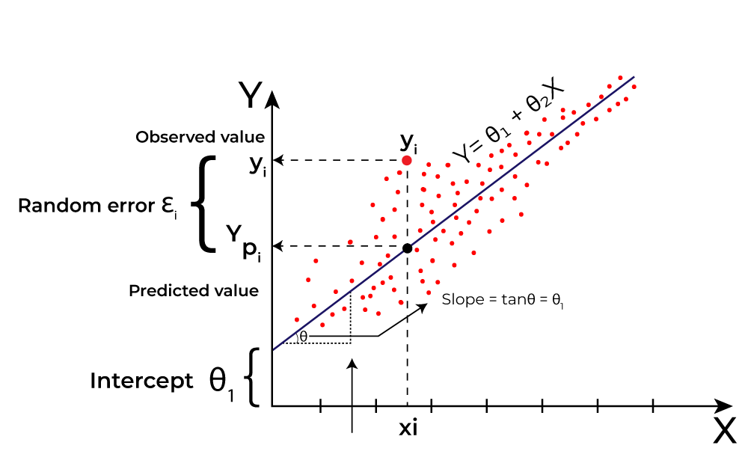
Best Fit Line in Linear Regression
It is the line that minimizes the difference between the actual data points and the predicted values from the model.
1. Goal of the Best-Fit Line :Here Y is called a dependent or target variable and X is called an independent variable also known as the predictor of Y

Slide 8
Best Fit Line in Linear Regression
2. Equation of the Best-Fit Line
For simple linear regression (with one independent variable), the best-fit line is represented by the equation
y = mx + b
Where:
  y is the predicted value (dependent variable)
  x is the input (independent variable)
  m is the slope of the line (how much y changes when x changes)
  b is the intercept (the value of y when x = 0)
The best-fit line will be the one that optimizes the values of m (slope) and b (intercept) so that the predicted y values are as close as possible to the actual data points.

Slide 9
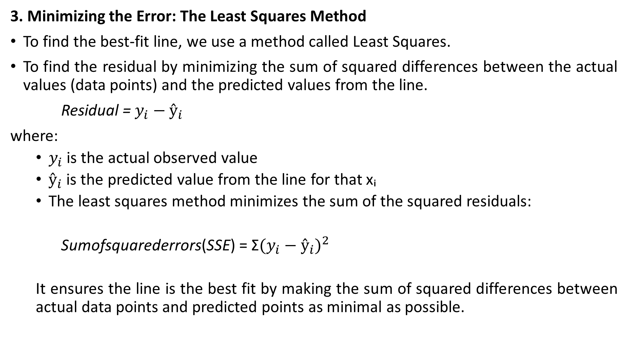
Best Fit Line in Linear Regression
3. Minimizing the Error: The Least Squares Method
To find the best-fit line, we use a method called Least Squares.
To find the residual by minimizing the sum of squared differences between the actual values (data points) and the predicted values from the line.
Residual = $y_{i}−ŷ_{i}$
where:
  $y_{i}$ is the actual observed value
  $ŷ_{i}$ is the predicted value from the line for that xᵢ
  The least squares method minimizes the sum of the squared residuals:
  Sumofsquarederrors(SSE) = Σ${(y_{i}−ŷ_{i})}^{2}$
  It ensures the line is the best fit by making the sum of squared differences between actual data points and predicted points as minimal as possible.

Slide 10
Best Fit Line in Linear Regression
4. Interpretation of the Best-Fit Line
Slope (m): The slope of the best-fit line indicates how much the dependent variable (y) changes with each unit change in the independent variable (x).
  Example: if the slope is 5, it means that for every 1-unit increase in x, the value of y increases by 5 units.
Intercept (b): The intercept represents the predicted value of y when x = 0. It’s the point where the line crosses the y-axis.

Slide 11
Hypothesis function in Linear Regression
Hypothesis function: used to make predictions about the dependent variable based on the independent variables. It represents the relationship between the input features and the target output.
For a simple case with one independent variable, the hypothesis function is:
h(x) = β₀ + β₁ x
where:
  h(x)(orŷ​) is the predicted value of the dependent variable (y).
  x is the independent variable.
  β₀ is the intercept, representing the value of y when x is 0.
  β₁ is the slope, indicating how much y changes for each unit change in x.

Slide 12
Hypothesis function in Linear Regression
For multiple linear regression (with more than one independent variable), the hypothesis function expands to:
h(x₁, x₂,...,xₖ) = β₀ + β₁x₁ + β₂x₂ + ... + βₖxₖ
where:
x₁, x₂,...,xₖ are the independent variables.
β₀ is the intercept.
β₁, β₂, ..., βₖ are the coefficients, representing the influence of each respective independent variable on the predicted output.

Slide 13
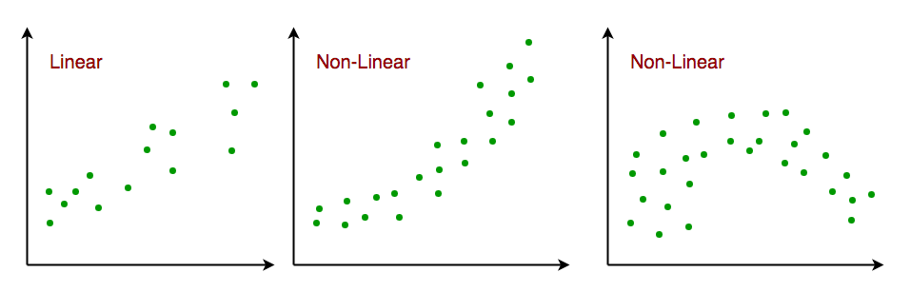
Assumptions of the Linear Regression
1. Linearity: The relationship between inputs (X) and the output (Y) is a straight line.
2. Independence of Errors: The errors in predictions should not affect each other.
3. Normality of Errors: The errors should follow a normal (bell-shaped) distribution.
4. No Multi-collinearity (for multiple regression): Input variables shouldn’t be too closely related to each other.

Slide 14
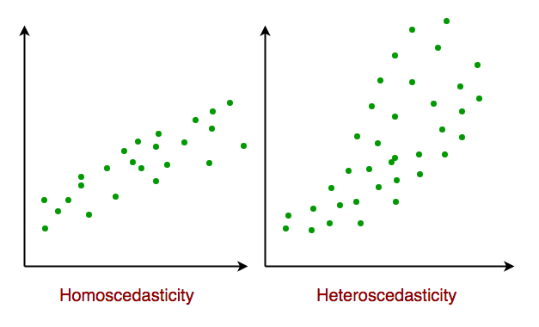
Assumptions of the Linear Regression
5. Constant Variance (Homoscedasticity): The errors should have equal spread across all values of the input. If the spread changes (like fans out or shrinks), it's called heteroscedasticity and it's a problem for the model.
6. No Autocorrelation: Errors shouldn't show repeating patterns, especially in time-based data.
7. Additivity: The total effect on Y is just the sum of effects from each X, no mixing or interaction between them.'

Slide 15
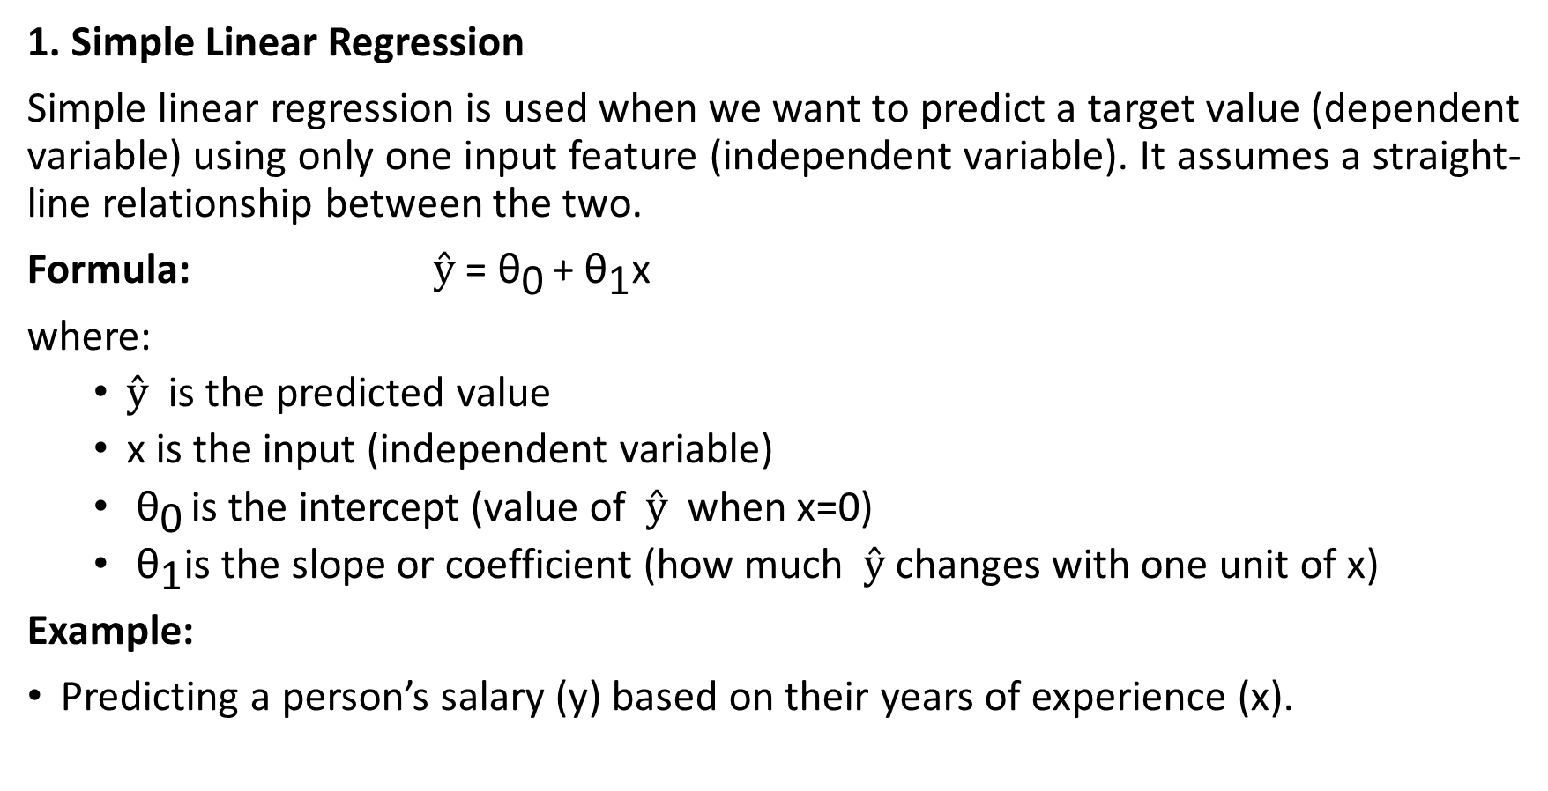
Types of Linear Regression
1. Simple Linear Regression
Simple linear regression is used when we want to predict a target value (dependent variable) using only one input feature (independent variable). It assumes a straight-line relationship between the two.
Formula: $ŷ$ ​= ${\text{θ}}_{\text{0} }$​+ ${\text{θ}}_{\text{1}}$​​x
where:
  $ŷ$​​ is the predicted value
  x is the input (independent variable)
  ​ ${\text{θ}}_{\text{0} }$is the intercept (value of $ŷ$​​​ when x=0)
  ​​ ${\text{θ}}_{\text{1}}$is the slope or coefficient (how much $ŷ$ changes with one unit of x)
Example:
Predicting a person’s salary (y) based on their years of experience (x).

Slide 16
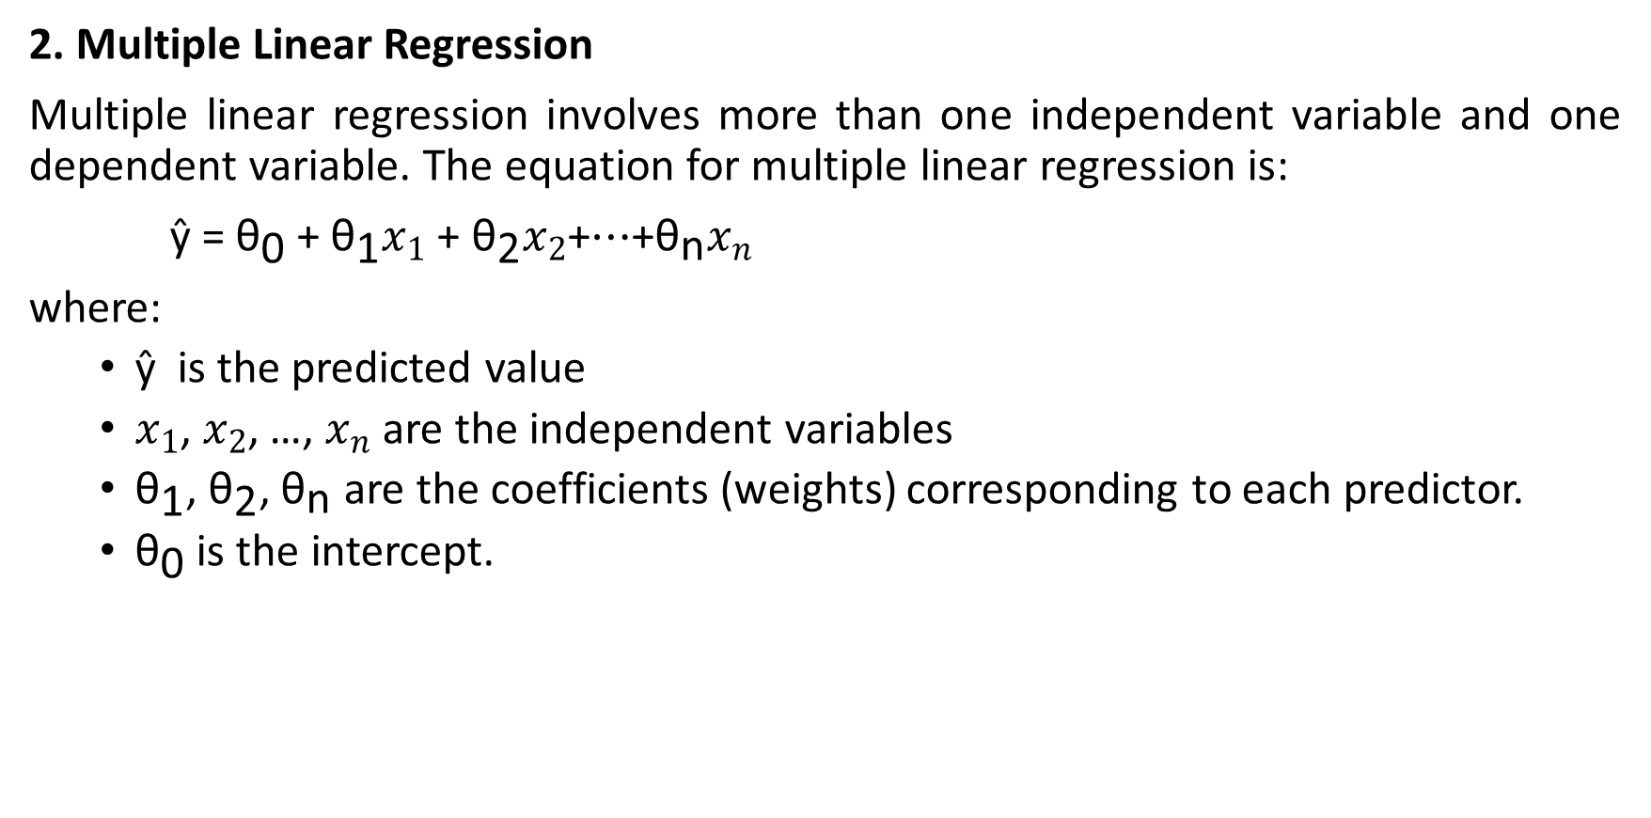
Types of Linear Regression
2. Multiple Linear Regression
Multiple linear regression involves more than one independent variable and one dependent variable. The equation for multiple linear regression is:
ŷ ​= ${\text{θ}}_{\text{0}}$​+ ${\text{θ}}_{\text{1}}x_{1}$​ ​+ ${\text{θ}}_{\text{2}}x_{2}$​+⋯+${\text{θ}}_{\text{n}}x_{n}$
where:
  ŷ ​​ is the predicted value
  $x_{1}$​, $x_{2}$, …, $x_{n}$ are the independent variables
  ${\text{θ}}_{\text{1}}$, ${\text{θ}}_{\text{2}}$, ${\text{θ}}_{\text{n}}$​ are the coefficients (weights) corresponding to each predictor.
  ${\text{θ}}_{\text{0}}$​ is the intercept.

Slide 17
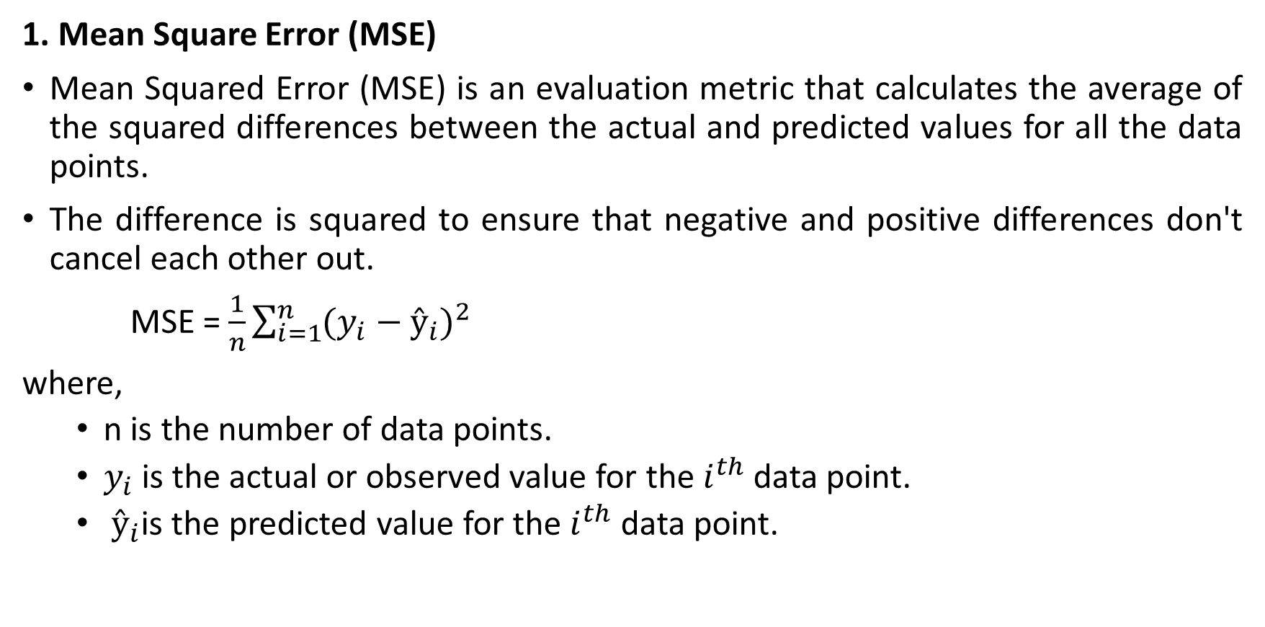
Evaluation Metrics for Linear Regression
1. Mean Square Error (MSE)
Mean Squared Error (MSE) is an evaluation metric that calculates the average of the squared differences between the actual and predicted values for all the data points.
The difference is squared to ensure that negative and positive differences don't cancel each other out.
MSE = $\frac{1}{n}\sum_{i=1}^{n}{{(y_{i}−ŷ_{i})}^{2}}$
where,
  n is the number of data points.
  $y_{i}$​is the actual or observed value for the $i^{th}$ data point.
  $ŷ_{i}$is the predicted value for the $i^{th}$ data point.

Slide 18
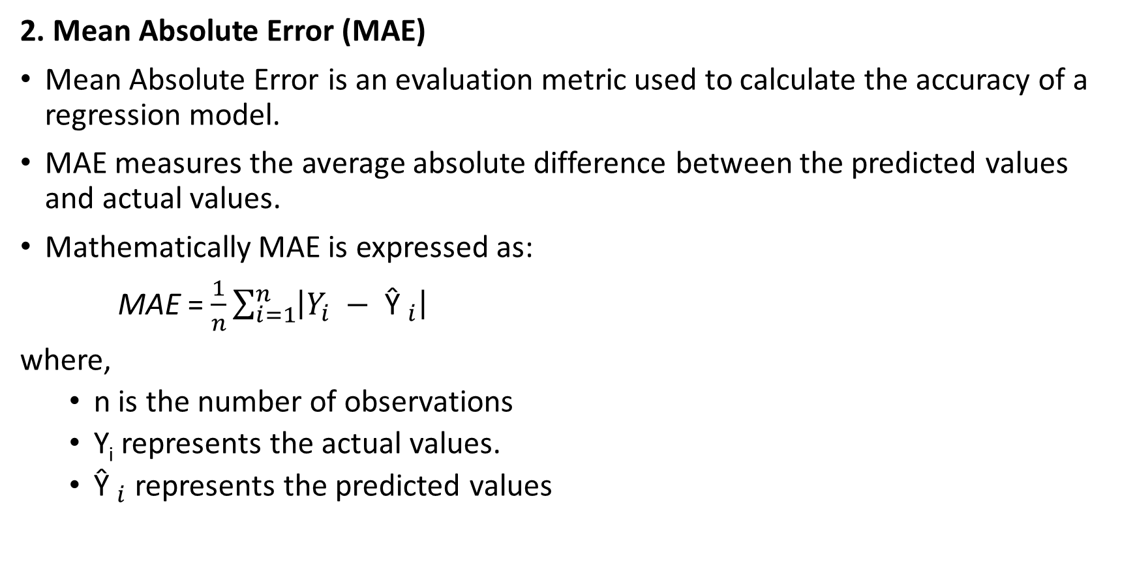
Evaluation Metrics for Linear Regression
2. Mean Absolute Error (MAE)
Mean Absolute Error is an evaluation metric used to calculate the accuracy of a regression model.
MAE measures the average absolute difference between the predicted values and actual values.
Mathematically MAE is expressed as:
MAE = $\frac{1}{n}\sum_{i=1}^{n}{\left|Y_{i} − {\text{Ŷ }}_{i}\right|}$
where,
  n is the number of observations
  Y_{i} represents the actual values.
  ${\text{Ŷ }}_{i}$ represents the predicted values

Slide 19
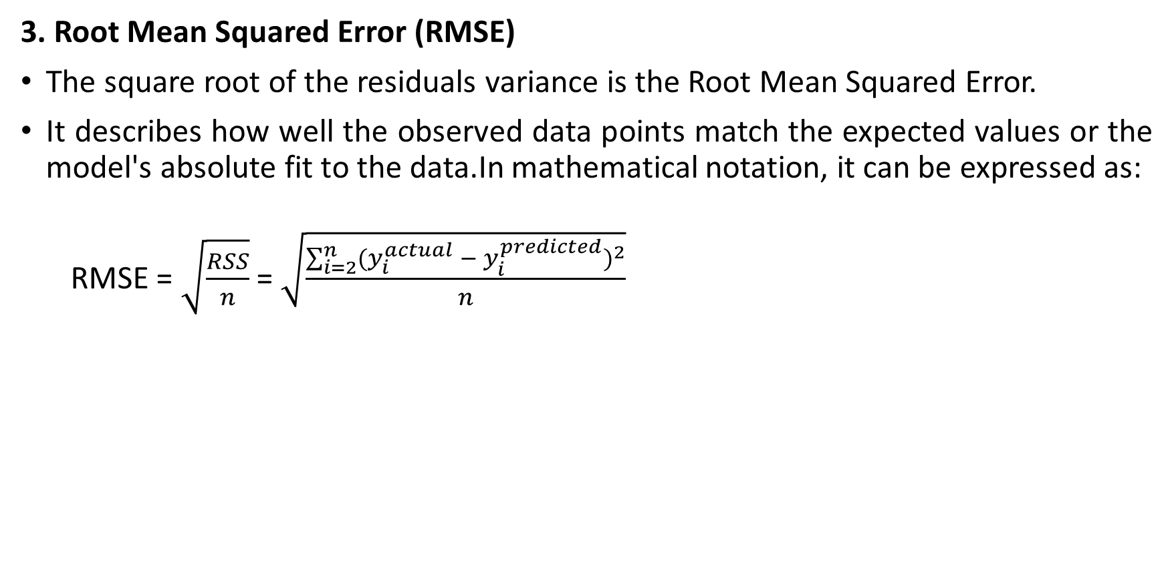
Evaluation Metrics for Linear Regression
3. Root Mean Squared Error (RMSE)
The square root of the residuals variance is the Root Mean Squared Error.
It describes how well the observed data points match the expected values or the model's absolute fit to the data.In mathematical notation, it can be expressed as:
  RMSE = $\sqrt{\frac{RSS}{n}}$ = $\sqrt{\frac{\sum_{i=2}^{n}{{(y_{i}^{actual} − y_{i}^{predicted})}^{2}}}{n}}$

Slide 20
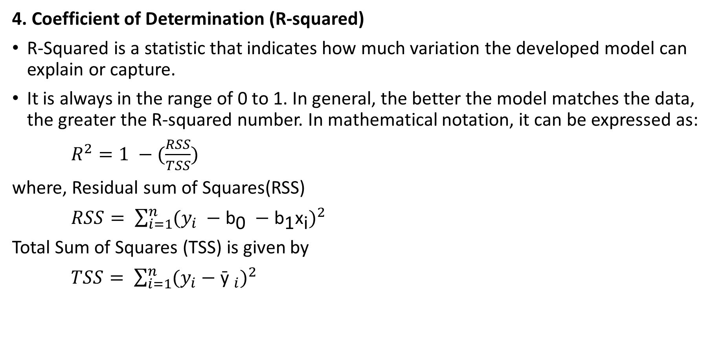
Evaluation Metrics for Linear Regression
4. Coefficient of Determination (R-squared)
R-Squared is a statistic that indicates how much variation the developed model can explain or capture.
It is always in the range of 0 to 1. In general, the better the model matches the data, the greater the R-squared number. In mathematical notation, it can be expressed as:
$R^{2}=1 −(\frac{RSS}{TSS})$
where, Residual sum of Squares(RSS)
$RSS= \sum_{i=1}^{n}{{(y_{i} −{\text{b}}_{\text{0}} −{\text{b}}_{\text{1}}{\text{x}}_{\text{i}})}^{2}}$
Total Sum of Squares (TSS) is given by
$TSS= \sum_{i=1}^{n}{{(y_{i}−{\text{ȳ }}_{i})}^{2}}$

Slide 21
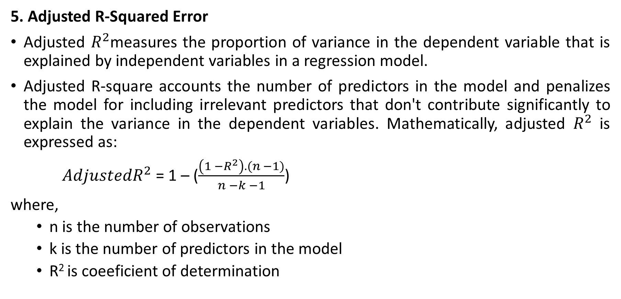
Evaluation Metrics for Linear Regression
5. Adjusted R-Squared Error
Adjusted $R^{2}$measures the proportion of variance in the dependent variable that is explained by independent variables in a regression model.
Adjusted R-square accounts the number of predictors in the model and penalizes the model for including irrelevant predictors that don't contribute significantly to explain the variance in the dependent variables. Mathematically, adjusted $R^{2}$ is expressed as:
$AdjustedR^{2}$ = 1 – ($\frac{\left(1 −R^{2}\right).(n −1)}{n −k −1}$)
where,
  n is the number of observations
  k is the number of predictors in the model
  R² is coeeficient of determination

Slide 22
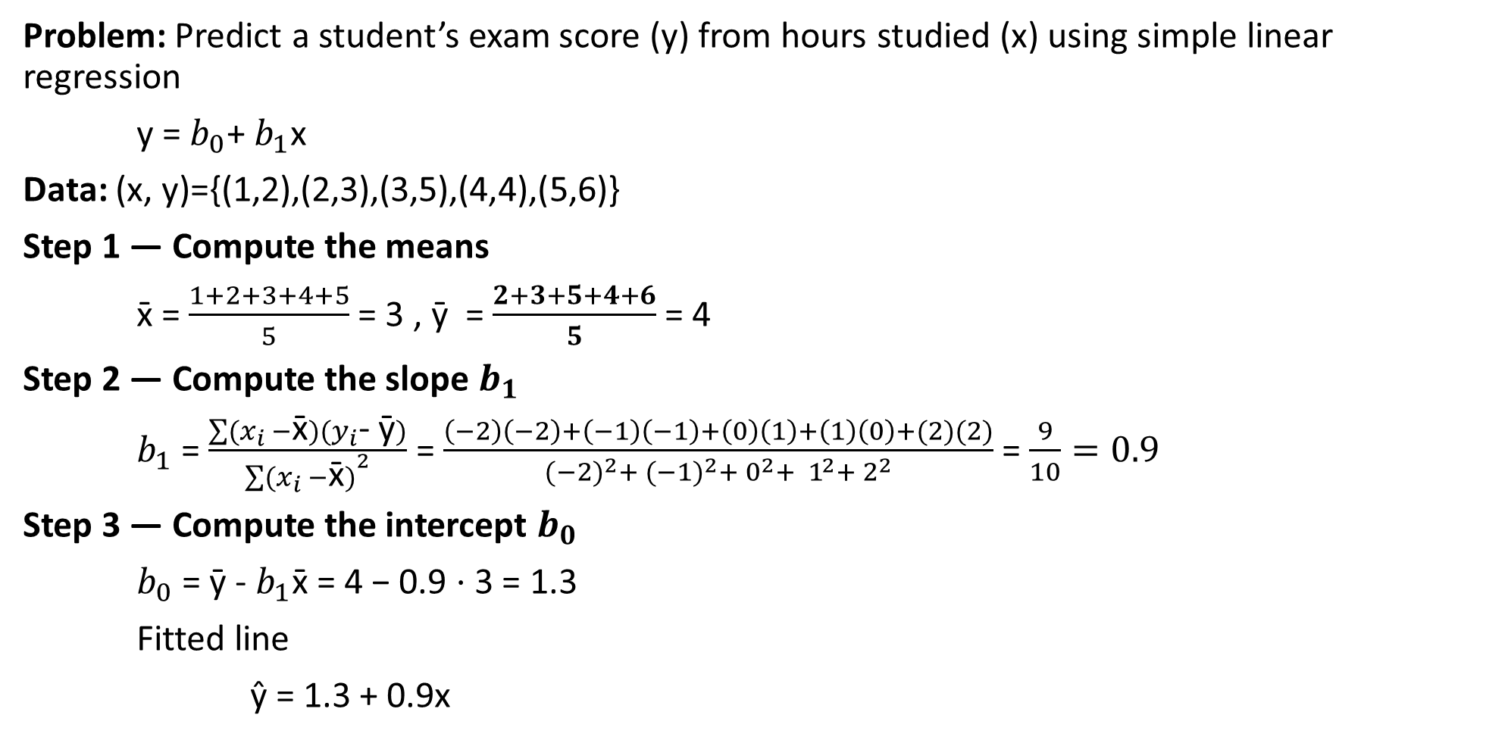
Example with Single Independent Variable
Problem: Predict a student’s exam score (y) from hours studied (x) using simple linear regression
y = $b_{0}$+ $b_{1}$x
Data: (x, y)={(1,2),(2,3),(3,5),(4,4),(5,6)}
Step 1 — Compute the means
x̄ = $\frac{1+2+3+4+5}{5}$ = 3 , ȳ = $\frac{2+3+5+4+6}{5}$ = 4
Step 2 — Compute the slope $b_{1}$
$b_{1}$ = $\frac{\sum{(x_{i} −\text{x}\text{̄})(y_{i}\text{- }\text{ȳ})}}{{\sum{(x_{i} −\text{x}\text{̄})}}^{2}}$ = $\frac{\left(−2\right)\left(−2\right)+\left(−1\right)\left(−1\right)+\left(0\right)\left(1\right)+\left(1\right)\left(0\right)+(2)(2)}{{(−2)}^{2}+ {(−1)}^{2}+ 0^{2}+ 1^{2}+ 2^{2}}$ = $\frac{9}{10}=0.9$
Step 3 — Compute the intercept $b_{0}$
$b_{0}$ = ȳ - $b_{1}$x̄ = 4 − 0.9 ⋅ 3 = 1.3
Fitted line
ŷ = 1.3 + 0.9x

Slide 23
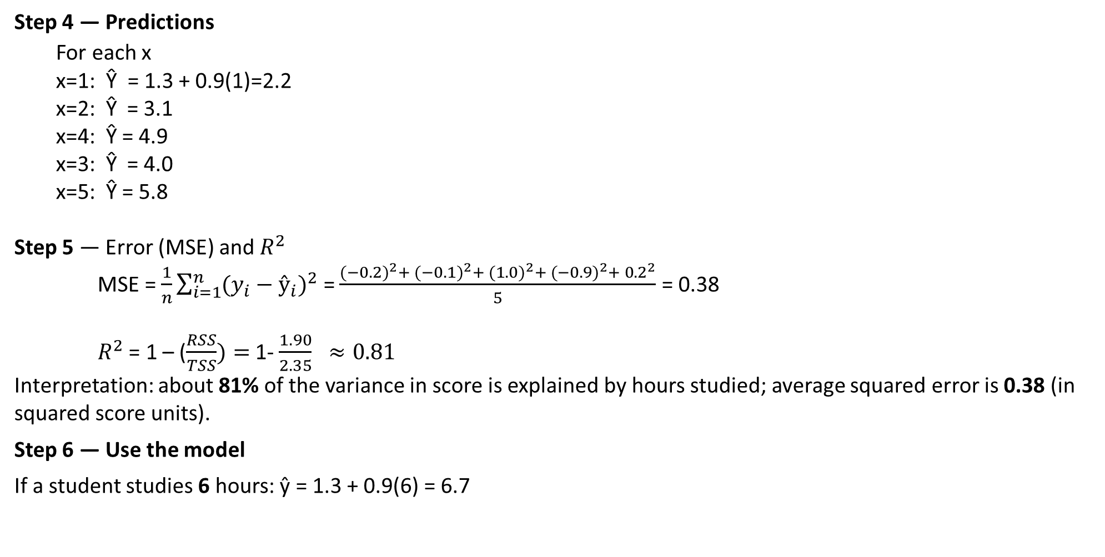
Example with Single Independent Variable
Step 4 — Predictions
  For each x
  x=1: $\text{Ŷ}$= 1.3 + 0.9(1)=2.2
  x=2: $\text{Ŷ}$ = 3.1
  x=4: $\text{Ŷ}$= 4.9
  x=3: $\text{Ŷ}$ = 4.0
  x=5: $\text{Ŷ}$= 5.8
Step 5 — Error (MSE) and $R^{2}$
MSE = $\frac{1}{n}\sum_{i=1}^{n}{{(y_{i}−ŷ_{i})}^{2}}$ = $\frac{{(−0.2)}^{2}+ {(−0.1)}^{2}+ {(1.0)}^{2}+ {(−0.9)}^{2}+ {0.2}^{2}}{5}$ = 0.38
$R^{2}$ = 1 – ($\frac{RSS}{TSS})=$1- $\frac{1.90}{2.35} ≈0.81$
Interpretation: about 81% of the variance in score is explained by hours studied; average squared error is 0.38 (in squared score units).
Step 6 — Use the model
If a student studies 6 hours: ŷ = 1.3 + 0.9(6) = 6.7

Slide 24

THANK YOU

